Slide 1
Meet the Teacher September 2025

Slide 2
All About Mr Green…
This is my thirtieth year in as a teacher.
I have taught in all the years from 2-5.

Slide 3
Our Vision…
And I will always guide you and satisfy you with good things. I will keep you strong and well. You will be like a garden that has plenty of water, like a spring of water that never goes dry.
(GNT Isaiah 58:11)
Believe-Grow-Achieve
Notes:
Our aim at All Saints Junior School is for every child to Believe in their own abilities and those around them, to Grow and develop continually and to Achieve the very best they can
3

Slide 4
Our key values to achieve this…
Compassion
Wisdom
Responsibility

Slide 5





Lunchtime…
Lunches
Caterlink menu for school dinners.
Healthy packed lunch.
Healthy snacks only.
Water bottle
Notes:
5

Slide 6



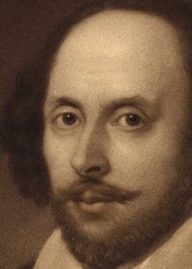

Guided Reading
These are the books that we will be reading this year.
Notes:
Text map always available to see.

Slide 7
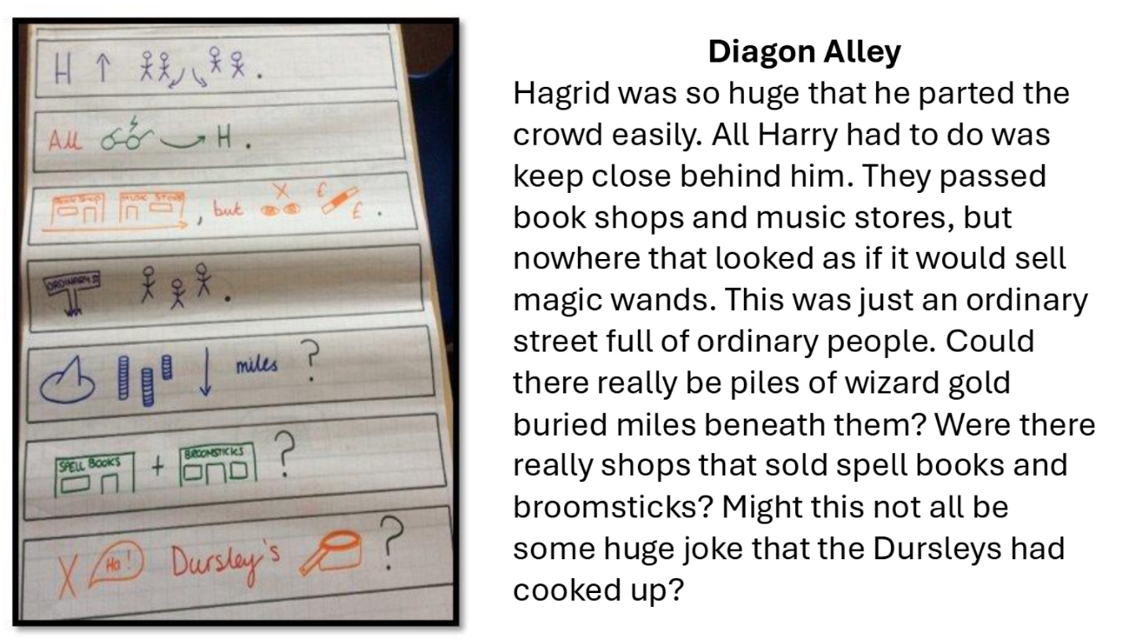
Talk4Writing

Slide 8
Maths
We will be focusing on place value, addition/ subtraction and multiplication/division.
Not about flying through the curriculum!
Opportunities to practice fluency and address misconceptions
About children learning not covering curriculum
Multiplicity of number
Notes:
This slide is to reinforce the idea that we will not rush maths. Children can learn something in a lesson but will forgot. So we will revisit and practice
Will be slowed down. Those that have mastered will get problem solving activities to apply knowledge.
8

Slide 9
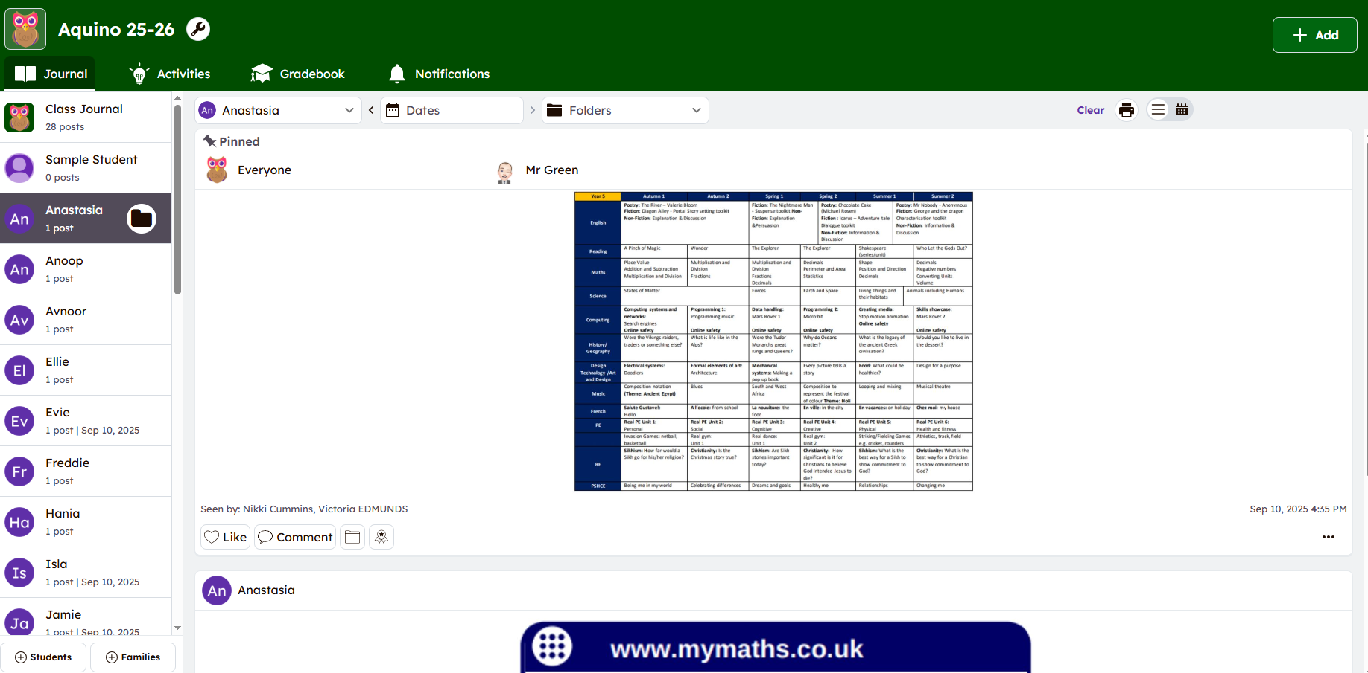
Seesaw

Slide 10
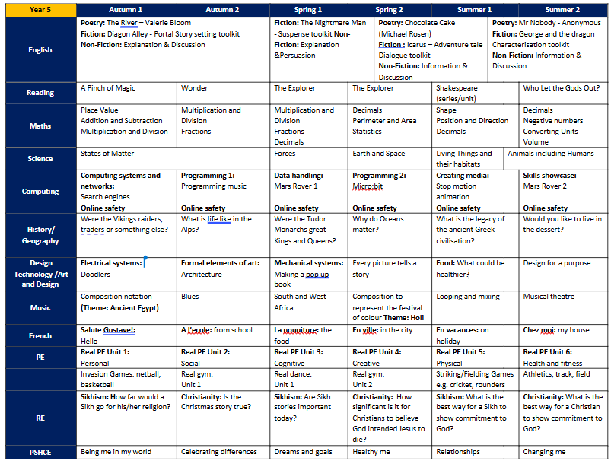

Slide 11



Homework:
Reading every night
Times Table Rockstars challenge
Homework club will happen each Wednesday lunch time.
We won't be sending paper copies home or expecting paper copies in.
English or maths or topic will be given out on a Wednesday and will be due in the following Wednesday, on Seesaw
Notes:
This will allow everyone to give feedback on the homework on class dojo and should be manageable.
11

Slide 12




Spelling:
All pupils must know all High frequency words. If not, these will be their spellings
Once secure on HF words, teachers will teach the class a spelling rule for 1-2 weeks depending on its complexity.
Pupils will have opportunities to use words with the spelling rule independently. This might be a short quiz or when reviewing vocabulary in T4W (these words will not be sent home)
Spelling is taught in all lessons

Slide 13
PE Days…
Tuesday – Outdoor PE
Friday– Indoor PE
Though this will probably change from term to term.
Please, can the children be in the correct kit on those days.

Slide 14
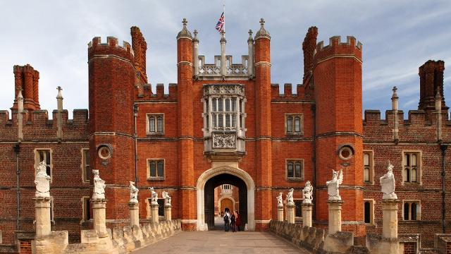
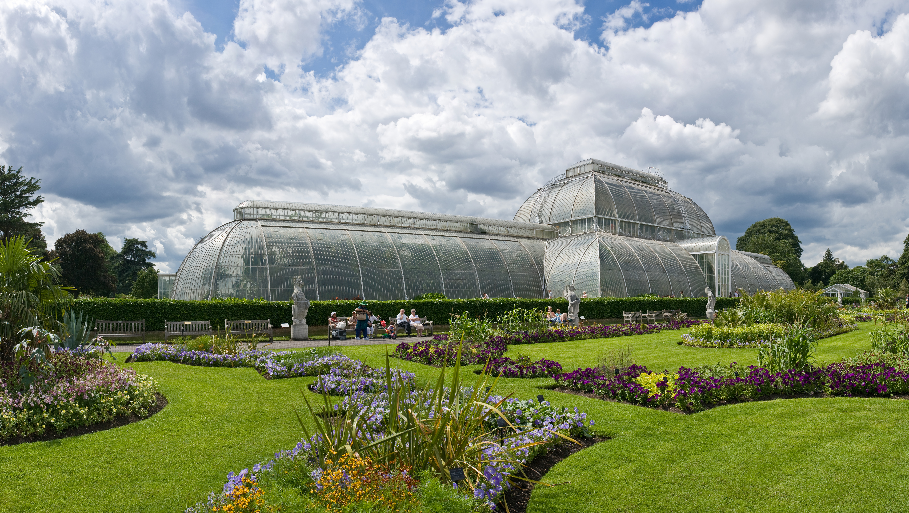
Trips

Slide 15
Dance festival
Community Day

Slide 16
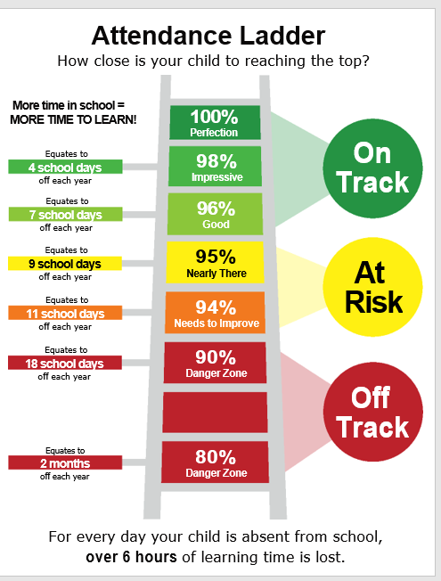
Attendance
Notes:
To remind parents how important attending school is. Mr Mckrell is our attendance lead and would make contact if attendance is below 94%.
16

Slide 17
Final reminders…
Gates open between 8.30-8.45am
Register at 8.45 (Gates will be closed, if late please sign in at the office)
No need to bring stationery, this will be provided in class

Slide 18
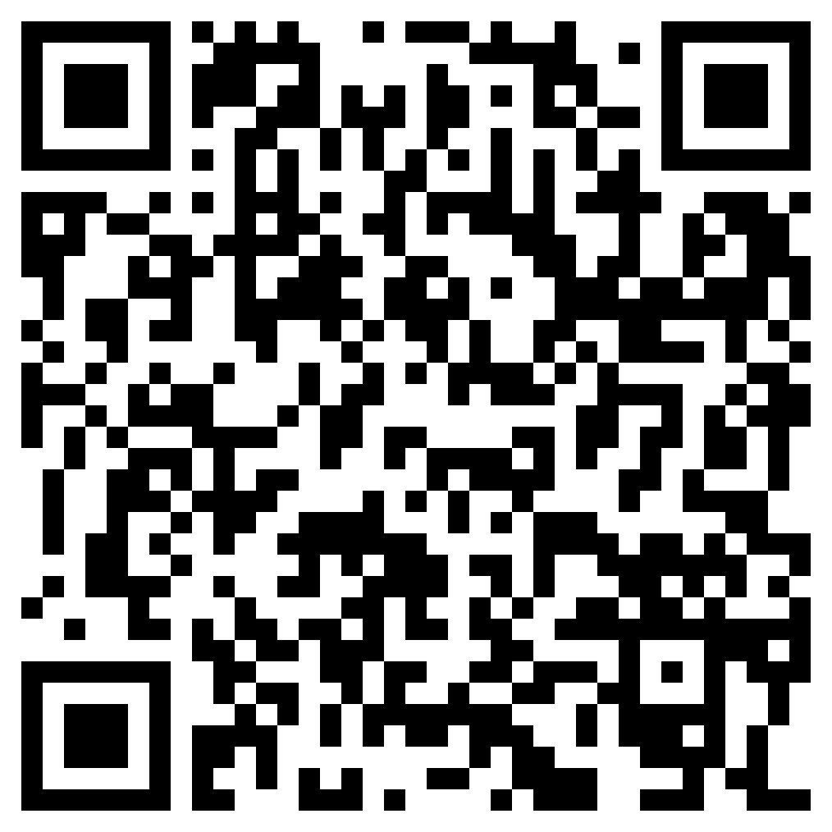
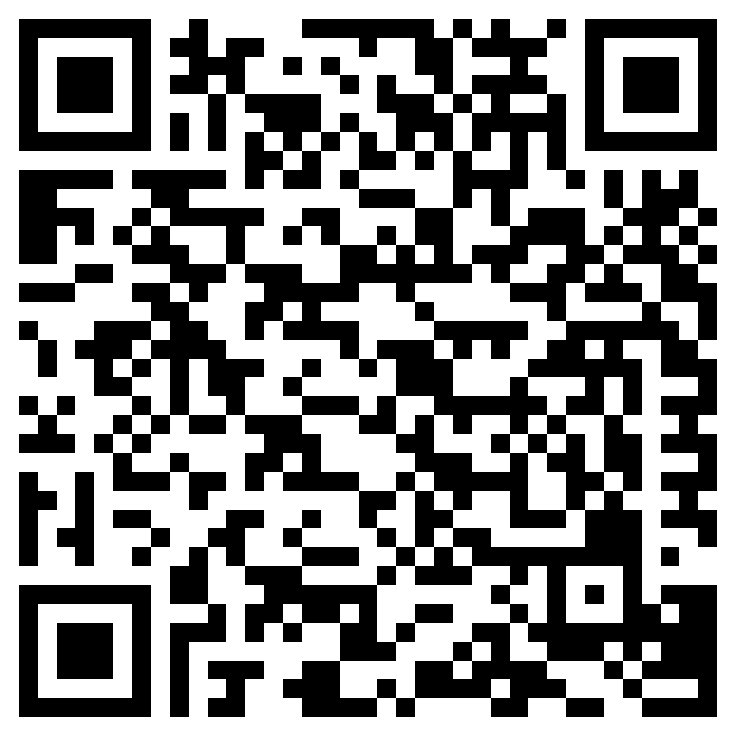
Recommended reading list…
Top 100 form the Reader Teacher
https://www.thereaderteacher.com/_files/ugd/d5a56e_a1fb08d3e08f4b149ba95e66bbfb4320.pdf?index=true
Books for Topic
https://www.booksfortopics.com/booklists/recommended-reads-2021-archive/year-5-2021/
Notes:
Use the relevant link for your year group. Print out and give to parents.
18

